Slide 1
SATS – Bi-Monthly Infra Review
June’26

Slide 2
Agenda
1 | Operational Summary
2 | Provisioning of NAT Gateway in COSYS+ Infrastructure
3 | COSYS+ PROD HTTPS FQDN URLs Rollout for SAUDI
4 | COSYS+ PROD HTTPS FQDN URLs Rollout for AAT
5 | COSYS+ TLS Security Compliance
6 | Azure Service(s) Retirement
Discussion on Azure operations updates and key infrastructure actions.

Slide 3
Operational Summary
Update Summary from past couple of Months –
Manage Engine Plugin Installation in COSYS+ Environment:
JVM Plugin in UAT & PROD – Completed.
AMQ Plugin in UAT & PROD – Completed.
Artemis AMQ Plugin Test in UAT – Completed.
Transition from Opsramp to ManageEngine – Final cutover for the transition from Opsramp to ManageEngine has been completed successfully – Completed.
Realignment of resources as per Resource Groups – Cloud-IMS has planned this activity to be executed in multiple phases due to resource movement dependencies. The phased implementation plan will be shared with the SATS team for review and approval – In-Progress.
Decommission of Non-Production VMs (QA APP1, QA APP5 and UAT APP1) – As per the application team's request, Cloud-IMS has successfully decommissioned the servers. – Completed.
COSYS+ WARA Report – Cloud-IMS received the COSYS+ WARA report from the SATS team for recommendation inputs. The required inputs have been successfully added and shared with the SATS team – Completed.

Slide 4
Operational Summary
Enabling Resource Health Alerts for VPN Gateways & its Connections – Based on the discussion in the COSYS+ WARA resiliency improvement meeting with the SATS team, Cloud-IMS have enabled Resource Health Alerts across all VPN Gateways & its Connections is required to strengthen resiliency – Completed.
Enabling Service Health Alerts for all COSYS+ resources – Based on the discussion in the COSYS+ WARA resiliency improvement meeting with the SATS team, Cloud-IMS have enabled Service Health Alerts across all Azure services is required to strengthen resiliency – Completed.
Provisioning of S2S connectivity between COSYS+ PROD to AISATS DXN PROD – Cloud-IMS has successfully provisioned the backup S2S tunnel for DXN-PROD – Completed.
Restriction of direct LB Access for COSYS+ AISATS (All tenants) & Saudi (All tenants) – Cloud-IMS has completed the activity in the UAT environment. For PROD, few changes have been made in the WAF exception list and gateway as few users were reporting issues in accessing the FQDN URLs. Further, the PROD rollout will be planned in a progressive phased manner – In-Progress.
Linux OS Patching for Vulnerability Remediation – Cloud-IMS has successfully completed the patching activity to remediate the vulnerability CVE-2026-31431 (Copy Fail). Additionally, based on the findings shared by the SATS Cybersecurity team, the vulnerability CVE-2026-43284 (DirtyFrag) was identified and successfully patched by Cloud-IMS – Completed.

Slide 5
Operational Summary
Enhancement of Printer & JVM Plugins in Manage Engine – Cloud-IMS has successfully updated the Printer and JVM plugins across all applicable COSYS+ servers, resulting in improved alert monitoring efficiency – Completed.
Onboarding of New Tenant GTR-MY:
NON-PROD Environment:
Cloud-IMS has successfully created the Site-to-Site tunnels for GTR MY – Completed.
Two VMs (ESB & SITA) have also been provisioned successfully – Completed.
Cloud-IMS has successfully configured the Load Balancer for NON-PROD environment – Completed.
Cloud-IMS have successfully configured FQDNs for accessing NON-PROD (STG & UAT) environments – Completed.
PROD Environment:
Cloud-IMS has successfully created the Site-to-Site tunnels for GTR MY – Completed.
Cloud-IMS have successfully configured FQDNs for accessing PROD environment – Completed.
Provisioning of SQL database – Completed.
Provisioning of ESB & SITA VMs – In-Progress.
Provisioning of Load balancer – Completed.

Slide 6
Provisioning of NAT Gateway in COSYS+ Infrastructure
Implementation of a NAT Gateway in COSYS+ Infrastructure – Cloud-IMS has received approval for the NAT Gateway implementation, however, approval for the activity schedule/phase in which the implementation will be carried out is still pending – Awaiting Implementation Schedule Approval
Proposed Nat Gateway | Environment | Phase | Schedule
 |  |  | Date | Time
NON-PROD
(new) COSYS-SEA-UAT2-NATGW | STG2 | Phase-1 |  | 12:30 PM – 3:00 PM SGT
(new) COSYS-SEA-UAT-NATGW | All Non-PROD+DevOps | Phase-2 |  | 12:30 PM – 3:00 PM SGT
(new) COSYS-CIN-UAT-Saudi-NATGW | UAT-SAUDI-ESBs | Phase-3 |  | 12:30 PM – 3:00 PM SGT
(new) COSYS-CIN-UAT-DXN-NATGW | UAT-DXN-ESBs | Phase-4 |  | 12:30 PM – 3:00 PM SGT
PROD
(new) COSYS-SEA-PRD-NATGW | PROD1 | Phase-5 |  | 12:30 PM – 3:00 PM SGT
(new) COSYS-SEA-PRD2-NATGW | PROD2 | Phase-6 |  | 12:30 PM – 3:00 PM SGT
(new) COSYS-CIN-PRD-Saudi-NATGW | PROD SAUDI ESBs | Phase-7 |  | 12:30 PM – 3:00 PM SGT

Slide 7
Provisioning of NAT Gateway in COSYS+ Infrastructure
Post successful implementation of NAT Gateway, Cloud-IMS will proceed with the decommission of the existing NAT infrastructure for both NON-PROD & PROD environment.
VM Name | Private IP | Public IP | Remarks
NON-PROD
COSYS-SEA-PRD-NAT2 | 10.130.6.4 | 13.76.195.224 | Can be decommissioned after Phase-4.
COSYS-SEA-PRD-NAT1 | 10.130.6.10 | NA | Standby VM.
PROD
COSYS-SEA-UAT-NAT1 | 10.130.10.4 | 137.116.136.189 | Can be decommissioned after Phase-2.

Slide 8
COSYS+ PROD HTTPS FQDN URLs Rollout for SAUDI
Rollout Status & Observations:
During the earlier rollout, users experienced 4xx errors across multiple URLs.
The issue has now been analyzed and addressed in coordination with Microsoft by adding IP-Based exception in WAF.
We can now proceed with the HTTPS rollout with improved confidence, as similar 4xx issues are not expected.
Current Observation:
Some intermittent 504 (timeout) errors are being observed.
These are mainly due to backend servers taking longer to respond than expected
The current Application Gateway timeout is set to 20 seconds, which may not be sufficient for certain requests.
Support Required from Application Team:
Review and confirm the appropriate backend response time / timeout requirement.
Suggest any required changes to Application Gateway timeout settings to avoid 504 errors.
Testing & Rollout Recommendation:
Conduct thorough testing before full rollout, either:
By the application team (if full access is available), or
With a limited set of users (phased approach)
This will help identify any remaining issues early and ensure a smooth rollout.
Recommended approach:
Phased HTTPS rollout, or
Run HTTP and HTTPS in parallel until HTTPS is fully stable

Slide 9
COSYS+ PROD HTTPS FQDN URLs Rollout for AAT
Issue Overview:
Users encountered 403 (Forbidden) errors while accessing certain application URLs.
The issue occurred after HTTPS was rolled out to all AAT users at once.
The Application Gateway’s Web Application Firewall (WAF) started blocking multiple requests considering them unsafe.
Root Cause:
The WAF (security layer) identified certain requests as potentially harmful and blocked them.
URLs containing patterns like “.php” and “.env” triggered security rules.
In UAT, the issue was not seen because WAF was in detection mode, but in production it was in prevention mode.
The full rollout (big-bang approach) increased impact instead of limiting it.
There was no advance communication to the support team, leading to delayed preparedness.
Investigation & Actions Taken:
Logs from Application Gateway were analyzed to identify blocked requests.
Problematic URLs were identified and temporary exceptions were added.
Multiple fixes were tried:
Allowing specific blocked URLs
Adding wildcard rules to reduce repeated blocking
Since issue persisted, a high-priority case was raised with Microsoft.
Microsoft suggested:
Separating IP and URL rules instead of combining them
Assigning higher priority to IP-based rules
Changes were implemented accordingly and validated.

Slide 10
COSYS+ PROD HTTPS FQDN URLs Rollout for AAT
Resolution & Next Steps:
Issue was resolved after adding IP-Based exception in WAF rules as per Microsoft recommendation.
Due to impact duration, customer temporarily rolled back to HTTP.
Cross-checked again the next day and found no Blockage from WAF in last 12 hours.
Future Rollout Plan:
Reattempt HTTPS rollout using a phased approach (starting with a limited user base) or maintain both HTTP and HTTPS in parallel until HTTPS is fully validated and stable.
Ensure WAF rules are pre-tested in prevention mode before go-live.
Follow proper change communication with all teams in advance.
Keep real-time monitoring during rollout to catch issues early.

Slide 11
COSYS+ TLS Security Compliance
As per recent communication by SATS Cybersecurity team regarding TLS handshake security requirements, we have checked both of our sites(satscargo.com & cargo.aat.com.hk) where we have found the below findings.
PROD1(satscargo.com) – The SSL policy attached to the Application Gateway is a legacy policy that includes older, RSA-based Cipher Suites which is the primary reason for the B rating on this URL, as it lacks Forward Secrecy support.
PROD1 – Recommendation:
Upgrade the SSL policy to the newer version to enable support for modern Cipher Suites and Forward Secrecy.
However, the current policy already includes the latest Cipher Suites, most requests are still negotiating using the older ones. Hence, Cloud-IMS needs to coordinate with the Application Team to confirm readiness before proceeding, as the new policy will remove support for the older Cipher Suites entirely.

Slide 12
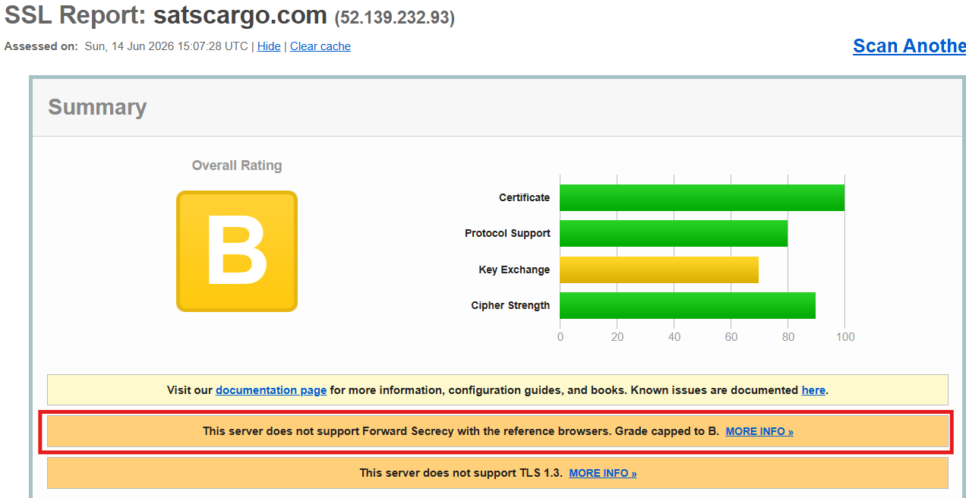
COSYS+ TLS Security Compliance
As per recent communication by SATS Cybersecurity team regarding TLS handshake security requirements, we have checked both of our sites(satscargo.com & cargo.aat.com.hk) where we have found the below findings.

Slide 13
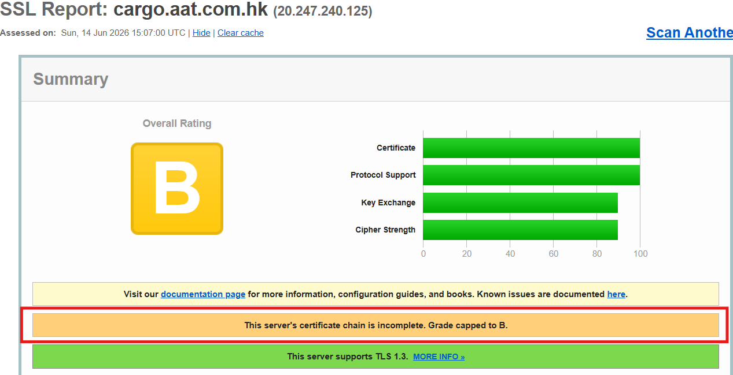
COSYS+ TLS Security Compliance
PROD2(cargo.aat.com.hk) – Intermediate CA certificate provided by the Certificate Authority is missing because of which we are getting the B rating for this URL.
PROD2 – Recommendation:
A full certificate bundle (Server + Intermediate + Root) will be requested from AAT and the complete bundle needs to be uploaded to resolve the issue.

Slide 14
Azure Service(s) Retirement
Note: There is no other upcoming retirement till Dec’26.

Slide 15
Let’s engage!

